Slide 1
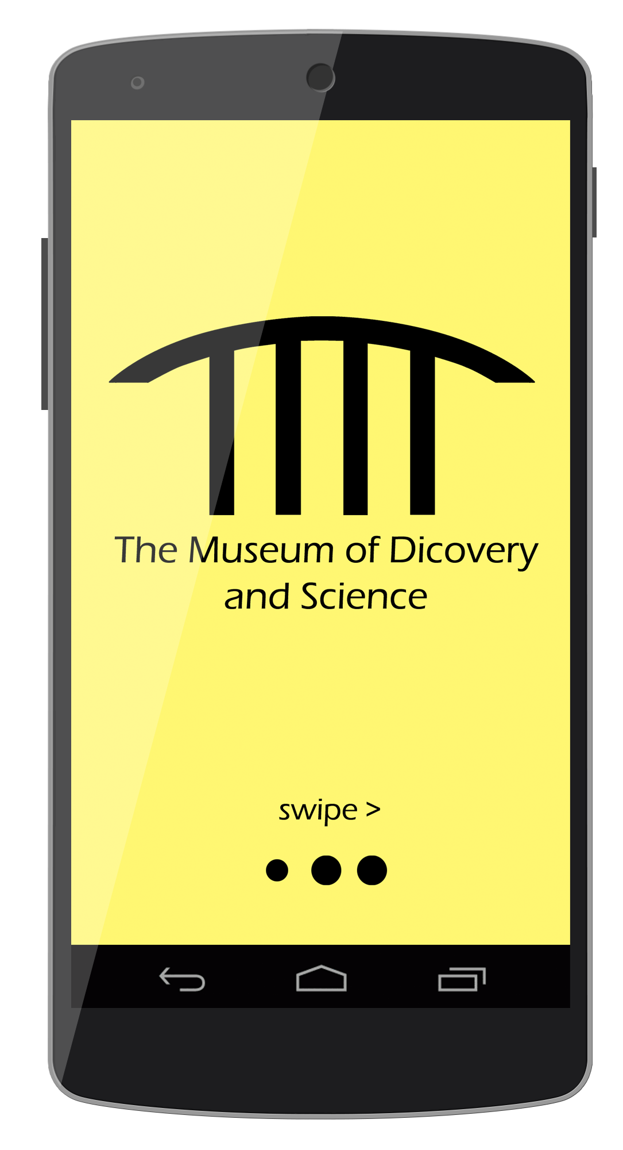
MODS App Presentation
Mobile Apps for Google Android
Summer 2014
Group 8

Slide 2
Why have a mobile app in the first place?
Be at the forefront of innovation!
Increase customer interaction with museum exhibits.
Yield information faster, and more effectively.
Reduce paper consumption; the application will take the place of printed fliers and maps.

Slide 3
What will our app offer museum staff?
Using tools such as Parse, customer analytics will provide museum staff with useful information such as:
Age demographics.
Popular exhibits.
Complaints.
Ideas for future exhibits.
With information provided by our app, the museum can then develop a more intimate relationship with its customers.

Slide 4
What will our app offer the customer?
An interactive map will allow customers to navigate the museum with ease.
Our app will be primarily geared towards the younger demographic:
“Stickers” and / or points will be awarded based upon exhibit interaction.
Once the customer has completed their visit, the total amount of collected stickers and / or points can be uploaded to a social media platform such as Twitter or Facebook.
NFC compatibility:
Users will have the power to interact with exhibits with a simple “bump” of their device.
Upon the detection of a tag, the user will be provided information relevant to the tag’s associated exhibit.
A list of exhibits and daily events will allow customers to better structure their museum experience.

Slide 5
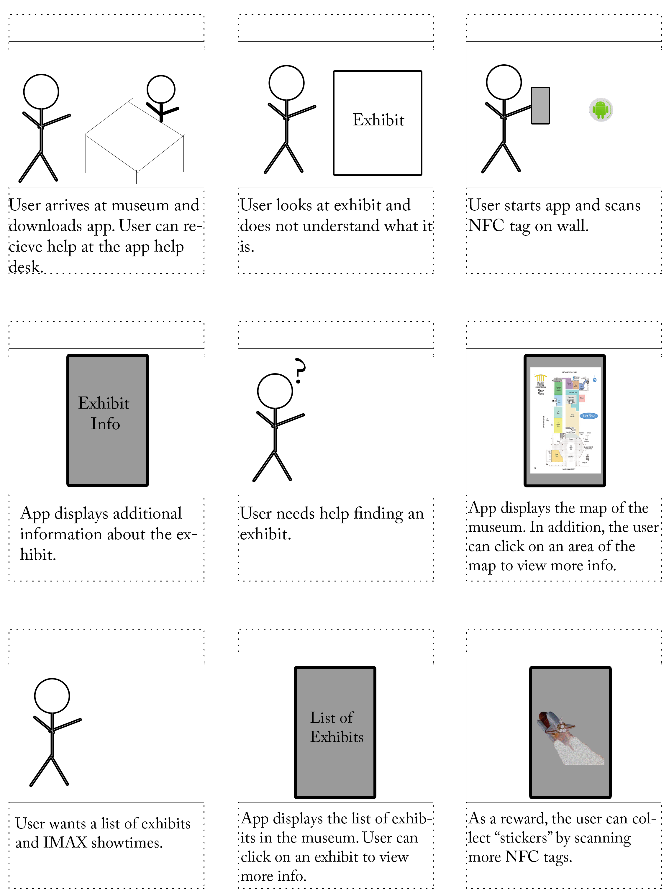
How will customers interact with the app?
Sample user interaction diagram »

Slide 6
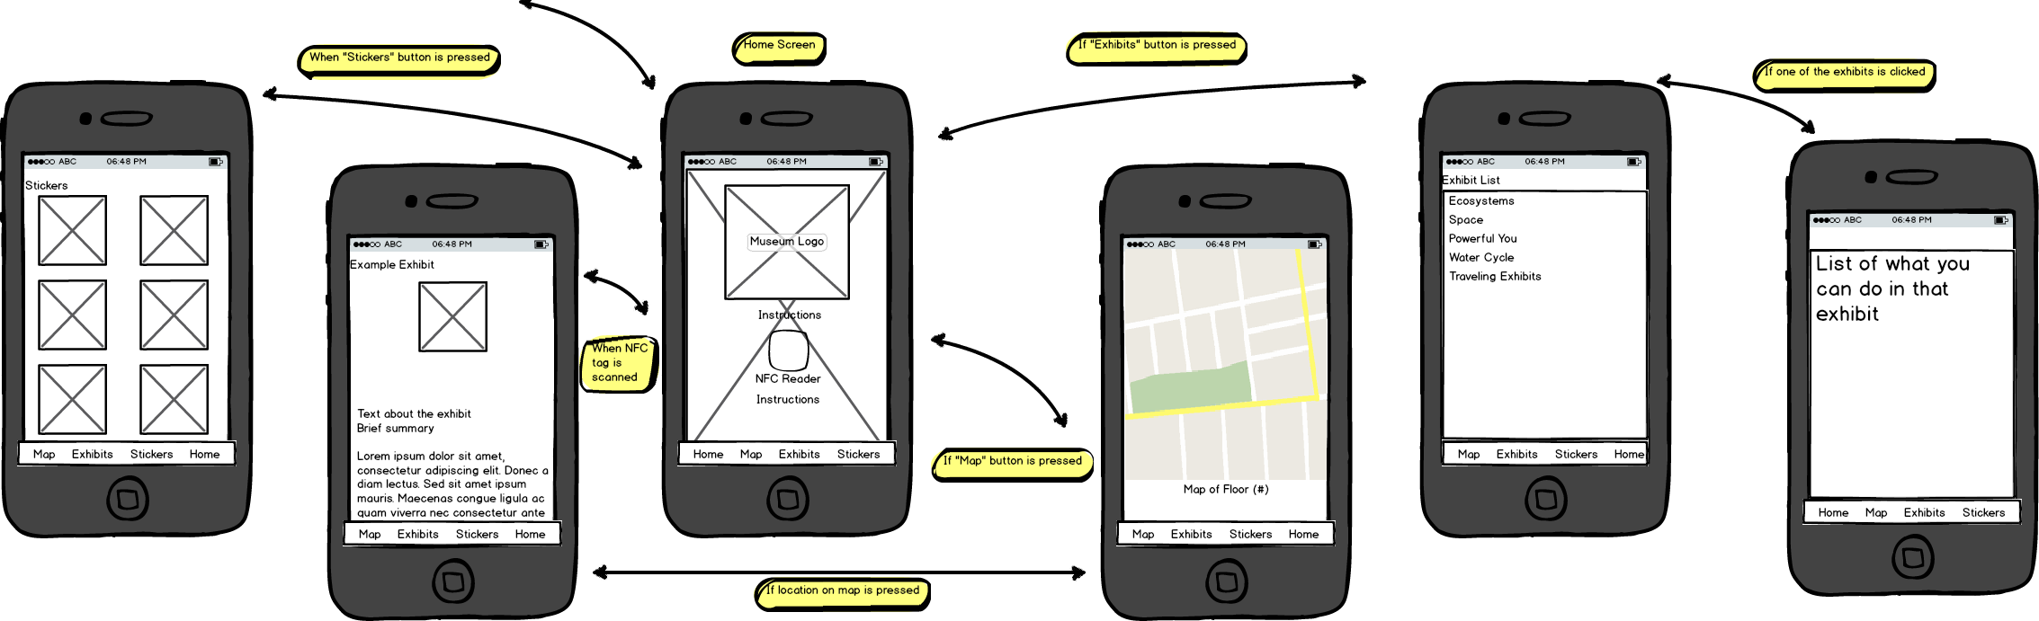
How will our app flow?
Sample wireframe »

Slide 7
Questions?

